Slide 1
Sprint 2 Presentation
Buddis

Slide 2
Documentation Updates

Slide 3
Changes to BRD
Refactored our entire BRD due to the previous BRD being about the previous app
Some changes include:
Primary market research
Secondary market research
User need
SWOT table

Slide 4
Changes to ADD
More tradeoff analysis
Language
Database
Frameworks
Extra Credit
Machine learning, cloud decisions, security decisions, etc.
We added many components that were missing to the ADD
Interface diagram
Sequence diagram
Major architecture Patterns Employed
etc.

Slide 5
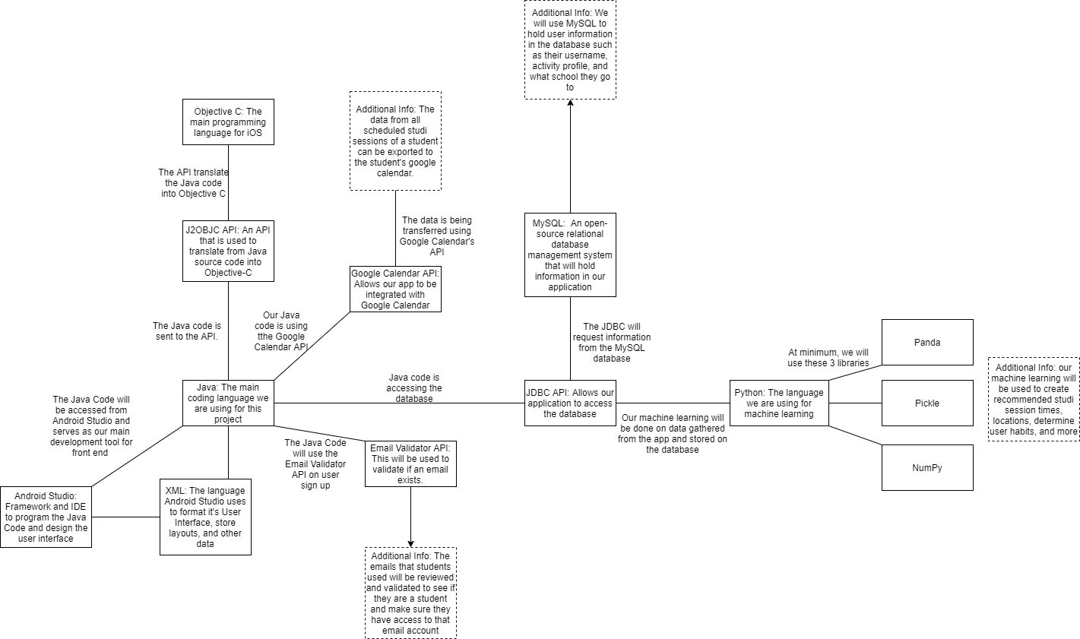
Update to Interface Diagram

Slide 6
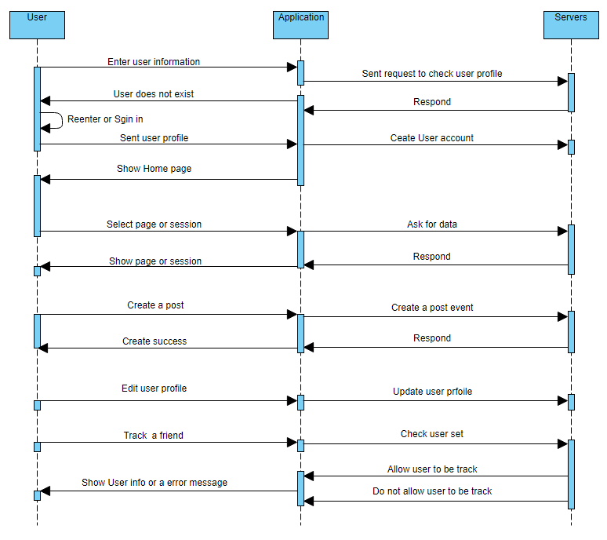
Sequence Diagram

Slide 7
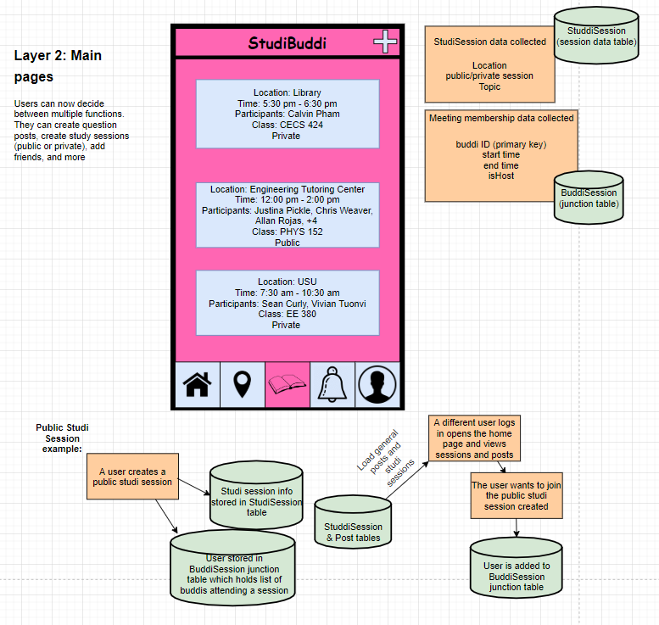
Data collection/flow

Slide 8
Code Aspects

Slide 9
Event-Driven Architecture
This type of architecture is best with applications with user interfaces
Our application will constantly be waiting for user input for the application to do anything.
Advantages
Add new features easily
Easily scalable
Disadvantages
High coupling could make it difficult to add new features
Error handling would become a nightmare

Slide 10
Client-Server Architecture
The client-server architecture is used for creating online applications with one server and multiple clients
Our application will be an online application that we will require a server
We need this for features such as creating posts, commenting on posts, and creating studi sessions

Slide 11

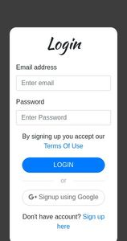



Front-end/back-end communication
INSERT INTO
Stored in MySQL database hosted in Amazon RDS
Main coding language for server
User signs up
Notes:
Mention or show on this slide the “main language”: java im pretty sure

Slide 12
Sprint Review

Slide 13
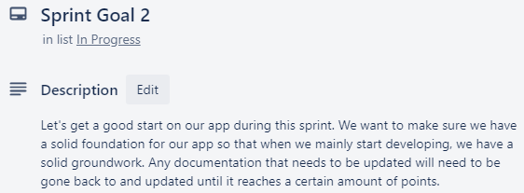
Sprint 2 goal

Slide 14
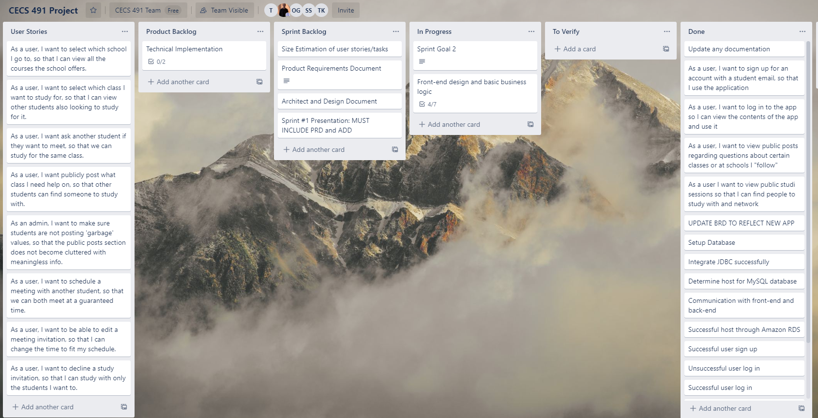
End of sprint 2 sprint board

Slide 15
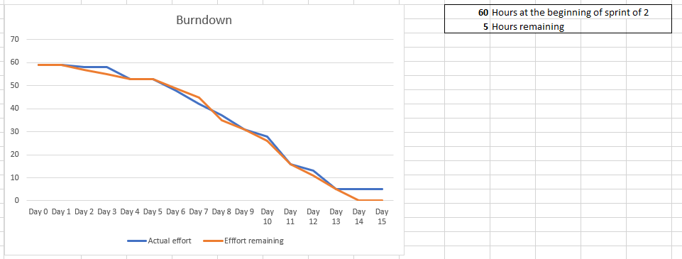
Burndown curve

Slide 16
Our code review
Verified and tested our code prior to release
Testing included:
Communicating data between front-end app and MySQL DB on multiple devices
Creating a user account and logging in successfully and unsuccessfully
Navigation through app isn’t broken

Slide 17
Sprint review
55/60 story points completed
Tasks planned and completed
Code release featuring:
Sign up and login page
Communication between front-end of app and MySQL DB via JDBC
Began home page and general app UI design
Updated BRD to reflect new app
Updated ADD
Tasks planned and not completed
Group decision of an accurate machine learning model for our need

Slide 18
User’s Stories Accomplished
Story points delivered to users are:
Signing up (5 points)
Logging in (5 points)

Slide 19
Sprint retrospective
Most important conclusion
Keeping everyone updated on what you’re working on is key
What went well
Finished more code and learned more technology than we expected
Completed both documentation and code through careful task delegation
What could be improved
Communication
What we’ll commit to doing next sprint
Planning out sprint goals and deadlines more carefully
Stronger communication throughout team and in our smaller task teams
Notes:
hello

Slide 20
Demo

